Slide 1
Optimal control strategies to prevent the hospital beds collapse during Covid-19 outbreak

Slide 2
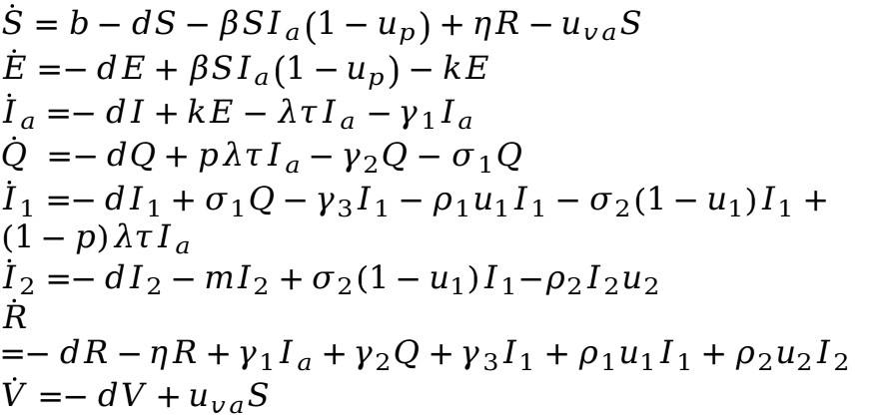
Mathematic model: state equations with control
$$\dot{S}=b−dS−βSI_{a}\left(1−u_{p}\right)+ηR−u_{va}S$$
$$\dot{E}=−dE+βSI_{a}\left(1−u_{p}\right)−kE$$
${\dot{I}}_{a}=−dI+kE−λτI_{a}$ $−γ_{1}I_{a}$
$\dot{Q} =−dQ+pλτI_{a}−γ_{2}Q−$ $σ_{1}Q$
${\dot{I}}_{1}=−dI_{1}+σ_{1}Q−γ_{3}I_{1}−ρ_{1}u_{1}I_{1}−σ_{2}\left(1−u_{1}\right)I_{1}+(1−p)λτI_{a}$
$${\dot{I}}_{2}=−dI_{2}−mI_{2}+σ_{2}(1−u_{1})I_{1}{−ρ}_{2}I_{2}u_{2}$$
$$\dot{R}=−dR−ηR+γ_{1}I_{a}+γ_{2}Q+γ_{3}I_{1}+ρ_{1}u_{1}I_{1}+ρ_{2}u_{2}I_{2}$$
$$\dot{V}=−dV+u_{va}S$$

Slide 3
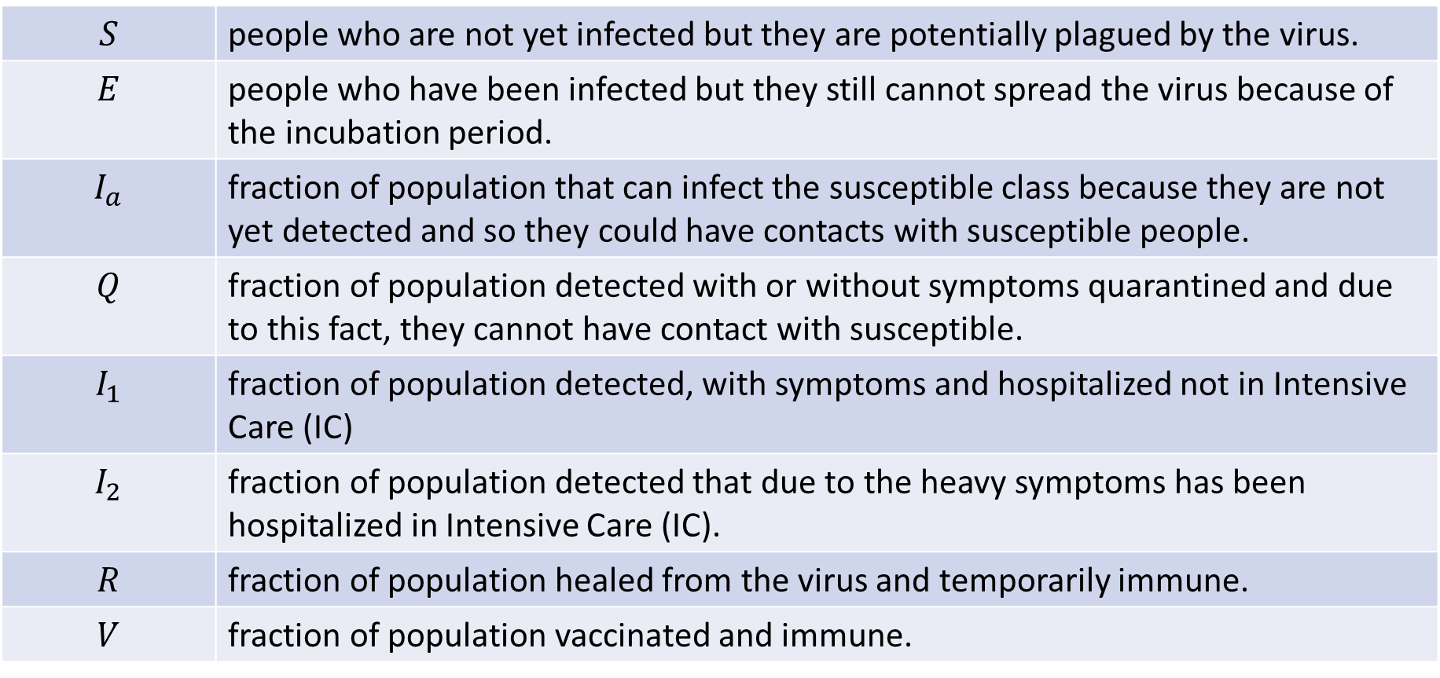
Compartments definition
$$S$$ | people who are not yet infected but they are potentially plagued by the virus.
$$E$$ | people who have been infected but they still cannot spread the virus because of the incubation period.
$$I_{a}$$ | fraction of population that can infect the susceptible class because they are not yet detected and so they could have contacts with susceptible people.
$$Q$$ | fraction of population detected with or without symptoms quarantined and due to this fact, they cannot have contact with susceptible.
$$I_{1}$$ | fraction of population detected, with symptoms and hospitalized not in Intensive Care (IC)
$$I_{2}$$ | fraction of population detected that due to the heavy symptoms has been hospitalized in Intensive Care (IC).
$$R$$ | fraction of population healed from the virus and temporarily immune.
$$V$$ | fraction of population vaccinated and immune.

Slide 4
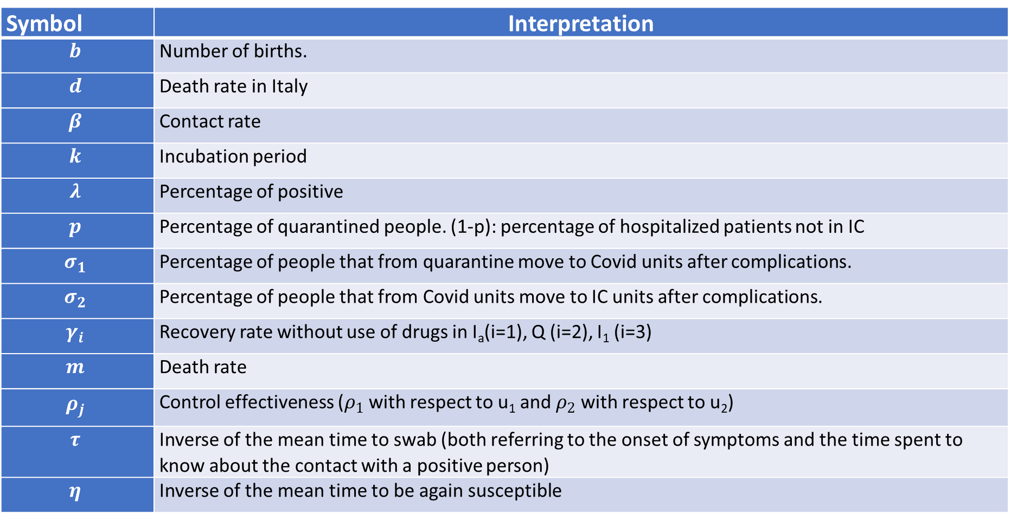
Model: parameters interpretation
Symbol | Interpretation
$$b$$ | Number of births.
$$d$$ | Death rate in Italy
$$β$$ | Contact rate
$$k$$ | Incubation period
$$λ$$ | Percentage of positive
$$p$$ | Percentage of quarantined people. (1-p): percentage of hospitalized patients not in IC
$$σ_{1}$$ | Percentage of people that from quarantine move to Covid units after complications.
$$σ_{2}$$ | Percentage of people that from Covid units move to IC units after complications.
$$γ_{i}$$ | Recovery rate without use of drugs in I_{a}(i=1), Q (i=2), I₁ (i=3)
$$m$$ | Death rate
$$ρ_{j}$$ | Control effectiveness ($ρ_{1}$ with respect to u₁ and $ρ_{2}$ with respect to u₂)
$$τ$$ | Inverse of the mean time to swab (both referring to the onset of symptoms and the time spent to know about the contact with a positive person)
$$η$$ | Inverse of the mean time to be again susceptible

Slide 5
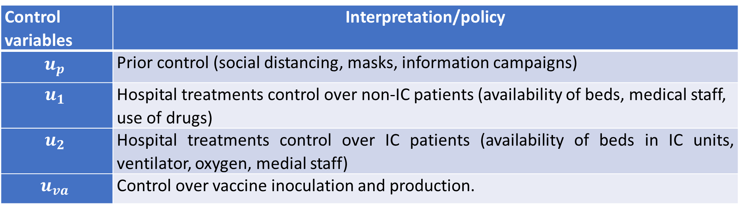
Model: control actions interpretation
We consider four different way to control the system:
Control variables | Interpretation/policy
$$u_{p}$$ | Prior control (social distancing, masks, information campaigns)
$$u_{1}$$ | Hospital treatments control over non-IC patients (availability of beds, medical staff, use of drugs)
$$u_{2}$$ | Hospital treatments control over IC patients (availability of beds in IC units, ventilator, oxygen, medial staff)
$$u_{va}$$ | Control over vaccine inoculation and production.
With $u_{p}∈\left[0,1\right],u_{1}∈\left[0,1\right],$ $u_{2}∈\left[0,1\right],$ $u_{va}∈\left[0,1\right]$

Slide 6



















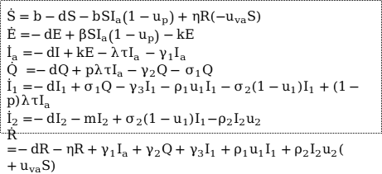

Block diagram
$$b$$
$$S$$
$$βI_{a}\left(1−u_{p}\right)$$
$$E$$
$$k$$
$$I_{a}$$
$$η$$
$$pλτ$$
$$(1−p)λτ$$
Each block has an implicit ougoing flow representing the death d
$$u_{va}$$
$$Q$$
$$σ_{1}$$
$$I_{1}$$
$$σ_{2}(1−u_{1})$$
$$I_{2}$$
$$m$$
$$γ_{3}+ρ_{1}u_{1}$$
$$γ_{2}$$
$$ρ_{2}u_{2}$$
$$\dot{S}=b−dS−bSI_{a}\left(1−u_{p}\right)+ηR(−u_{va}S)$$
$$\dot{E}=−dE+βSI_{a}\left(1−u_{p}\right)−kE$$
${\dot{I}}_{a}=−dI+kE−λτI_{a}$ $−γ_{1}I_{a}$
$\dot{Q} =−dQ+pλτI_{a}−γ_{2}Q−$ $σ_{1}Q$
${\dot{I}}_{1}=−dI_{1}+σ_{1}Q−γ_{3}I_{1}−ρ_{1}u_{1}I_{1}−σ_{2}\left(1−u_{1}\right)I_{1}+(1−p)λτI_{a}$
$${\dot{I}}_{2}=−dI_{2}−mI_{2}+σ_{2}(1−u_{1})I_{1}{−ρ}_{2}I_{2}u_{2}$$
$$\dot{R}=−dR−ηR+γ_{1}I_{a}+γ_{2}Q+γ_{3}I_{1}+ρ_{1}u_{1}I_{1}+ρ_{2}I_{2}u_{2}(+u_{va}S)$$
$$R$$
$$γ_{1}$$
$$V$$

Slide 7
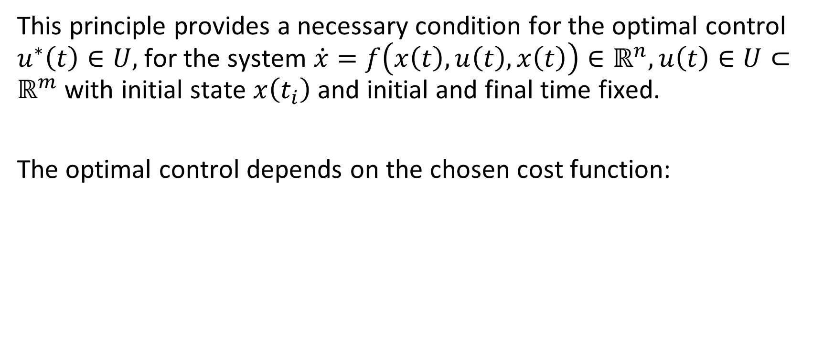
Pontryagin maximum principle: Definitions
This principle provides a necessary condition for the optimal control $u^{∗}\left(t\right)∈U,$for the system $\dot{x}=f\left(x\left(t\right), u\left(t\right),x\left(t\right)\right)∈ℝ^{n}, u\left(t\right)∈U⊂ℝ^{m}$ with initial state $x\left(t_{i}\right)$and initial and final time fixed.
The optimal control depends on the chosen cost function:

Slide 8
Obiettivi ottimizzazione
Minimizzare il numero di persone ospedalizzate con sintomi (non in terapia intensiva)
Minimizzare il numero di persone ospedalizzate in TI
Minimizzare lo sforzo dei controlli applicati

Slide 9
Strategie
Prima strategia: massimizzare i suscettibili
Seconda strategia: minimizzare direttamente gli ospedalizzati e la terapia intensiva
Terza strategia: massimizzare i suscettibili e minimizzare gli ospedalizzati e in TI
Quarta strategia: massimizzare il numero di vaccinati

Slide 10
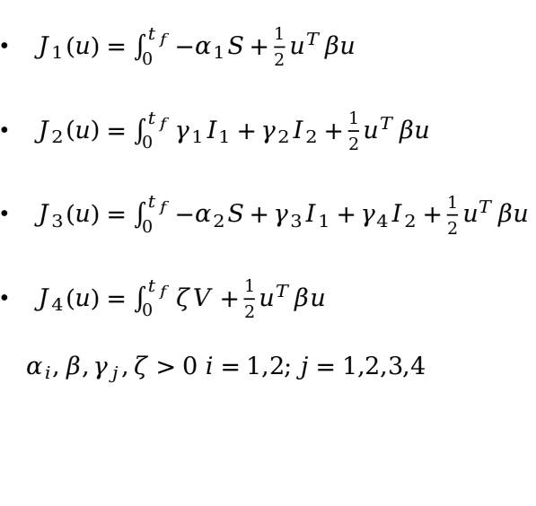
Funzioni di costo
Vincoli
$J_{1}\left(u\right)=\int_{0}^{t_{f}}{{−α}_{1}S+{\frac{1}{2}u}^{T}βu}$
$J_{2}\left(u\right)=\int_{0}^{t_{f}}{γ_{1}I_{1}+γ_{2}I_{2}+{\frac{1}{2}u}^{T}βu}$
$J_{3}\left(u\right)=\int_{0}^{t_{f}}{{−α}_{2}S+γ_{3}I_{1}+γ_{4}I_{2}+{\frac{1}{2}u}^{T}βu}$
$J_{4}\left(u\right)=\int_{0}^{t_{f}}{ζV+\frac{1}{2}u^{T}βu}$
$$α_{i},β,γ_{j},ζ>0 i=1,2;j=1,2,3,4$$

Slide 11
Applicazione Pontryagin

Slide 12
Fitting parametri modello
Prima di effettuare l’ottimizzazione puntiamo a far aderire il modello ai dati reali al fine di avere al momento dell’ottimizzazione dei risultati che possono rispecchiare per certi versi le reali possibilità usando strategie di controllo ottimo offerte da Matlab.

Slide 13
Risultati fitting

Slide 14
Risultati/simulazione: Prima strategia
Funzione di costo, risultati (simulazione) e interpretazione/commento

Slide 15
Risultati/simulazione: seconda strategia
Funzione di costo, risultati (simulazione) e interpretazione/commento

Slide 16
Risultati/simulazione: terza strategia
Funzione di costo, risultati (simulazione) e interpretazione/commento

Slide 17
Risultati/simulazione: quarta strategia
Funzione di costo, risultati (simulazione) e interpretazione/commento

Slide 18
Comparazione strategie e commenti sullo sforzo del controllo

Slide 19
Conclusioni

